Slide 1
Domain ML
Technology: Python
ANALYZING SOCIAL MEDIA DATA THROUGH DATA MINING

Slide 2

INDEX
Abstract
Objective
Future scopes
Problem statement
Introduction
Literature review
Existing Method
Drawbacks
Proposed method
Advantages
Applications
Implementation
Modules
Hardware and Software Requirements
Algorithms
UML Diagrams
Results
Conclusion
References

Slide 3
OBJECTIVE
The primary goal of this project is to analyse social media data using data mining to determine whether social media text input can be classified as positive, negative, or neutral using Decision Tree, Random Forest, Naive Bias, and NLP machine learning approaches.
FUTURE SCOPES
The future scope of this project involves expanding the analysis to incorporate more social media platforms, integrating sentiment analysis with real-time monitoring, exploring deep learning techniques for improved classification accuracy, and developing applications for brand reputation management and targeted marketing.

Slide 4
PROBLEM STATEMENT
The problem is to analyze social media data using data mining and NLP machine learning approaches to classify social media text as positive, negative, or neutral. The goal is to determine the effectiveness of Decision Tree, Random Forest, and Naive Bayes algorithms for sentiment analysis in social media data.

Slide 5
ABSTRACT
Nowadays, people from all around the world use social media sites to share information. Twitter for example is a platform in which users send, read posts known as ‘tweets’ and interact with different communities. Users share their daily lives, post their opinions on everything such as brands and places. Companies can benefit from this massive platform by collecting data related to opinions on them. The aim of this paper is to present a model that can perform sentiment analysis of real data collected from Twitter. Data in Twitter is highly unstructured which makes it difficult to analyse. However, our proposed model is different from prior work in this field because it combined the use of supervised and unsupervised machine learning algorithms. The process of performing sentiment analysis as follows: Tweet extracted directly from Twitter API, then cleaning and discovery of data performed. After that the data were fed into several models for the purpose of training. Each tweet extracted classified based on its sentiment whether it is a positive, negative or neutral. Data were collected on two subjects McDonalds and KFC to show which restaurant has more popularity. Different machine learning algorithms were used. The result from these models were tested using various testing metrics like cross validation and f-score. Moreover, our model demonstrates strong performance on mining texts extracted directly from Twitter.

Slide 6
INTRODUCTION
The online social media such as Twitter, Facebook, and Instagram allow users to communicate with the whole world. Write their own opinions about products or share their moments, even influence politics and companies. Twitter for example, almost every huge company have an account on Twitter to know about their customers feedback about their services or products. Sentiment analysis, known as opinion mining, for classifying specific words into positive or negative. In this paper, we used sentiment analysis to classify specific English tweets about two restaurants. our research was determining which one better than other, in specific we examined weather specific tweets is positive, negative, neutral.
In gives a focus on analyzing tweets in written English language, belong to different telecommunication companies, for performing opinion mining on it, they used a supervised machine learning algorithms for classification. Moreover, they used measure how important word is to a specific tweet. develops sentiment analysis approach embedded in public tweets comments.

Slide 7
and Twitter for example is a platform in which users send, read posts known as ‘tweets’ and interact with different communities. Users share their daily lives, post their opinions on everything such as brands and places. Companies can benefit from this massive platform by collecting data related to opinions on them. The aim of this paper is to present a model that can perform sentiment analysis of real data collected from Twitter. Data in Twitter is highly unstructured which makes it difficult to analyse. However, our proposed model is different from prior work in this field because it combined the use of supervised and unsupervised machine learning algorithms. The process of performing sentiment analysis as follows: Tweet extracted directly from Twitter API, then cleaning and discovery of data performed. After that the data were fed into several models for the purpose of training. Each tweet extracted classified based on its sentiment whether it is a positive, negative or neutral. Data were collected on two subjects McDonalds and KFC to show which restaurant has more popularity. Different machine learning algorithms were used. The result from these models were tested using various testing metrics like cross validation and f-score. Moreover, our model demonstrates strong performance on mining texts extracted directly from Twitter. They used supervised machine learning algorithms such as Decision Tree, Random Forest and Naïve Bayes, and they used NLP to see the effect of several terms weighting functions on the accuracy. In applies NLP in twitter dataset, they used natural language analysis for Arabic language text. Researchers in present a sentiment analysis for corpus such as tweets,

Slide 8
LITERATURE SURVEY
S. No | Journal Type with year | Authors | Title | Outcomes
1 | IEEE, 2017 | Karlapudi Naga Manasa | Sentiment analysis of twitter data using Machine learning algorithms | In thispaper, we discussed sentiment analysis of English-language tweets from Saudi Arabian telecommunications companies Mobily, STC, and Zain.Positive, negative, and neutral classifications were theconsidered
2 | IEEE, 2016 | Vishal A. Kharde | Sentiment Analysis of Twitter Data: A Survey of Techniques | In this research, we present an overview and comparative analysis of the existing methods for opinion mining, including lexicon-based and machine learning approaches,

Slide 9
S. No | Journal Type with year | Authors | Title | Outcomes
3 | IEEE, 2020 | Ali Mustafa Qamar, Suliman A | Sentiment Classification of Twitter Data Belonging to Saudi Arabian Telecommunication Companies | In this article, we present a comprehensive and comparative analysis of the existing methodologies for opinion mining, including lexicon-based and machine learning approaches, cross-domain techniques, and assessment metrics.
4 | IEEE, 2021 | Belgacem Brahimi a, Mohamed Touahria | Improving sentiment analysis in Arabic: A combined approach | This Paper discussed how to categories movie reviews written in Arabic based on their emotional content. This work contributes by offering strategies for obtaining pertinent perspectives in order to enhance review classification outcomes.

Slide 10
EXISTING SYSTEM
EXISTING METHOD
The increasing growth of machine learning, computer techniques divided into traditional methods and machine learning methods. This section describes the related works of classification of a Analysing social media data through data mining Using Machine Learning Model Detection and how machine learning methods are better than traditional methods. The existing method in this project have a certain flow is used for model development Decision Tree and Naïve bias are used algorithms in existing system. But it requires large memory and result is not accurate.
Disadvantages:
1. Accuracy low
2. Requires more time
3. Difficult to handle

Slide 11
PROPOSED SYSTEM
Many machine learning algorithms are available for prediction and diagnosis a Analysing social media data through data mining Some of the machine learning algorithm are Decision Tree, Random Forest. We used proposed Analysing social media data through data mining In this stage we have first implement Random Forest Classifier algorithm on these dataset and the implement algorithm individual then we are implement Voting Ensemble algorithm for combine these results and an compute the final accuracy.
Advantages:
Highest accuracy
Reduces time complexity.
Easy to use

Slide 12
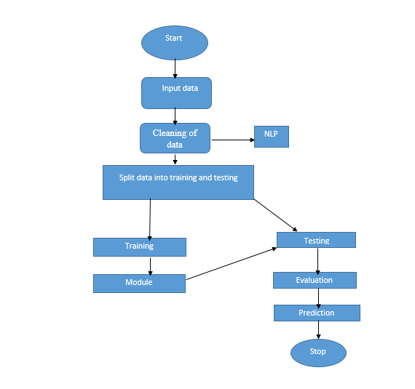
PROPOSED METHOD

Slide 13
APPLICATIONS
Brand Reputation Management: By analyzing social media data and classifying text as positive, negative, or neutral, businesses can monitor their brand reputation in real-time. They can identify and address negative sentiment or customer complaints promptly, allowing them to take appropriate actions to mitigate any potential damage to their brand image.
Customer Feedback Analysis: Social media platforms serve as a valuable source of customer feedback. Analyzing social media text using machine learning algorithms can help businesses gain insights into customer opinions, sentiments, and preferences. This information can be used to improve products, services, and customer experiences.

Slide 14
Hardware and Software Requirements
H/W Configuration:
• Processor - I3/Intel Processor
• Hard Disk -160 GB
• RAM - 8 GB
S/W Configuration:
• Operating System : Windows 7/8/10 .
• Server side Script : HTML, CSS & JS.
• IDE : Pycharm.
• Libraries Used : Numpy, IO, OS, Django, keras.
• Technology : Python 3.6+.

Slide 15
MODULES
MODULES:
User:
Register:
Users can register for the Social media web application here.
Login:
After registering, the user can access his portal.
1.3 Upload:
Upload dataset which is downloaded from the kaggle
View Data:
View data before preprocessing

Slide 16
View preprocessing:
View data after preprocessing (cleaned dataset)
Input :
User will give the input.
Result History:
After giving the inputs, model will predict the result which it was set according to performance, it will predict that the Social media text is positive, negative, or neutral.
.
Take Dataset:
The dataset for the Twitter is collected from the kaggle website (kaggle.com).
The size of overall dataset is 19.9 MB.

Slide 17
Pre-processing:
In preprocessing first of all we will check whether there is any Nan values.
If any Nan values is present we will fill the Nan values with different fillna techniques like bfill, ffill, mode, and mean.
Here we used the ffill (front fill) technique on our project.
And apply the NLP concepts.
Training the data:
Irrespective of the algorithm we select the training is the same for every algorithm.
Given a dataset we split the data into two parts training and testing, the reason behind doing this is to test our model/algorithm performance just like the exams for a student the testing is also exam for the model.

Slide 18
We can split data into anything we want but it is just good practice to split the data such that the training has more data than the testing data, we generally split the data.And for training and testing there are two variables X and Y in each of them, the X is the features that we use to predict the Y target and same for the testing also.Then we call the .fit ( ) method on any given algorithm which takes two parameters i.e., X and Y for calculating the math and after that when we call the .predict ( ) giving our testing X as parameter and checking it with the accuracy score giving the testing Y and predicted X as the two parameters will get our accuracy score and same steps , these are just checking for how good our model performed on a given dataset
We are using
RandomForestClassifier: In RandomForestClassifier we are fitting the X_train and Y_train in our model .Based on this we are testing the data which is fitted based on that we get the accuracy.
DecisionTreeClassifier: In DecisionTreeClassifier we are fitting the X_train and Y_train in our model .Based on this we are testing the data which is fitted based on that we get the accuracy.
GaussianNB: In GaussianNB we are fitting the X_train and Y_train in our model .Based on this we are testing the data which is fitted based on that we get the accuracy.

Slide 19
ALGORITHMS
1. Random Forest:
A random forest is a machine learning technique that’s used to solve regression and classification problems. It utilizes ensemble learning, which is a technique that combines many classifiers to provide solutions to complex problems.
A random forest algorithm consists of many decision trees. The ‘forest’ generated by the random forest algorithm is trained through bagging or bootstrap aggregating. Bagging is an ensemble meta-algorithm that improves the accuracy of machine learning algorithms.
The (random forest) algorithm establishes the outcome based on the predictions of the decision trees. It predicts by taking the average or mean of the output from various trees. Increasing the number of trees increases the precision of the outcome.
A random forest eradicates the limitations of a decision tree algorithm. It reduces the over fitting of datasets and increases precision. It generates predictions without requiring many configurations in packages (like Scikit-learn).

Slide 20
Features of a Random Forest Algorithm:
• It’s more accurate than the decision tree algorithm.
• It provides an effective way of handling missing data.
• It can produce a reasonable prediction without hyper-parameter tuning.
• It solves the issue of over fitting in decision trees.
• In every random forest tree, a subset of features is selected randomly at the node’s splitting point.
Decision trees are the building blocks of a random forest algorithm. A decision tree is a decision support technique that forms a tree-like structure. An overview of decision trees will help us understand how random forest algorithms work.
A decision tree consists of three components: decision nodes, leaf nodes, and a root node. A decision tree algorithm divides a training dataset into branches, which further segregate into other branches. This sequence continues until a leaf node is attained. The leaf node cannot be segregated further.

Slide 21
2.Decision Tree
A tree has many analogies in real life, and turns out that it has influenced a wide area of machine learning, covering both classification and regression. In decision analysis, a decision tree can be used to visually and explicitly represent decisions and decision making. As the name goes, it uses a tree-like model of decisions. Though a commonly used tool in data mining for deriving a strategy to reach a particular goal.
A decision tree is drawn upside down with its root at the top. In the image on the left, the bold text in black represents a condition/internal node, based on which the tree splits into branches/ edges. The end of the branch that doesn’t split anymore is the decision/leaf, in this case, whether the passenger died or survived, represented as red and green text respectively.
Although, a real dataset will have a lot more features and this will just be a branch in a much bigger tree, but you can’t ignore the simplicity of this algorithm. The feature importance is clear and relations can be viewed easily. This methodology is more commonly known as learning decision tree from data and above tree is called Classification tree as the target is to classify passenger as survived or died. Regression trees are represented in the same manner, just they predict continuous values like price of a house. In general, Decision Tree algorithms are referred to as CART or Classification and Regression Trees.

Slide 22
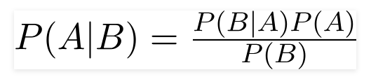
3.NAIVE BAYES:
A Naive Bayes classifier is a probabilistic machine learning model that’s used for classification task. The crux of the classifier is based on the Bayes theorem.
Using Bayes theorem, we can find the probability of A happening, given that B has occurred. Here, B is the evidence and A is the hypothesis. The assumption made here is that the predictors/features are independent. That is presence of one particular feature does not affect the other. Hence it is called naive.
Let’s understand it using an example. Below I have a training data set of weather and corresponding target variable ‘Play’ (suggesting possibilities of playing). Now, we need to classify whether players will play or not based on weather condition. Let’s follow the below steps to perform it.
Step 1: Convert the data set into a frequency table
Step 2: Create Likelihood table by finding the probabilities like Overcast probability = 0.29 and probability of playing is 0.64.

Slide 23
UML DIAGRAMS
UML stands for Unified Modelling Language. UML is a standardized general-purpose modelling language in the field of object-oriented software engineering. The standard is managed, and was created by, the Object Management Group. The goal is for UML to become a common language for creating models of object-oriented computer software. In its current form UML is comprised of two major components: a Meta-model and a notation. In the future, some form of method or process may also be added to; or associated with, UML.
The Unified Modelling Language is a standard language for specifying, Visualization, Constructing and documenting the artifacts of software system, as well as for business modelling and other non-software systems.
The UML represents a collection of best engineering practices that have proven successful in the modelling of large and complex systems.
The UML is a very important part of developing objects-oriented software and the software development process. The UML uses mostly graphical notations to express the design of software projects

Slide 24
GOALS:
The Primary goals in the design of the UML are as follows:
Provide users a ready-to-use, expressive visual modelling Language so that they can develop and exchange meaningful models.
Provide extendibility and specialization mechanisms to extend the core concepts.
Be independent of particular programming languages and development process.
Provide a formal basis for understanding the modelling language.
Encourage the growth of OO tools market.
Support higher level development concepts such as collaborations, frameworks, patterns and components.
Integrate best practices.

Slide 25
Use case diagram:
A use case diagram in the unified modeling language (uml) is a type of behavioral diagram defined by and created from a use-case analysis. Its purpose is to present a graphical overview of the functionality provided by a system in terms of actors, their goals (represented as use cases), and any dependencies between those use cases. The main purpose of a use case diagram is to show what system functions are performed for which actor. Roles of the actors in the system can be depicted.

Slide 26
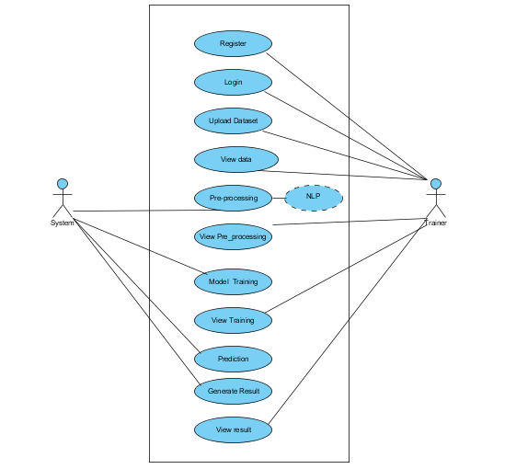

Slide 27
Class diagram:
In software engineering, a class diagram in the unified modeling language (uml) is a type of static structure diagram that describes the structure of a system by showing the system's classes, their attributes, operations (or methods), and the relationships among the classes. It explains which class contains information.

Slide 28
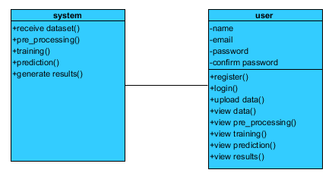

Slide 29
Sequence diagram:
A sequence diagram in unified modeling language (uml) is a kind of interaction diagram that shows how processes operate with one another and in what order. It is a construct of a message sequence chart. Sequence diagrams are sometimes called event diagrams, event scenarios, and timing diagrams.

Slide 30
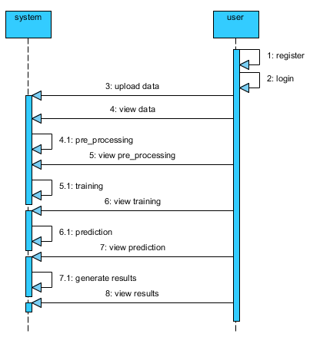

Slide 31
Collaboration diagram:
In collaboration diagram the method call sequence is indicated by some numbering technique as shown below. The number indicates how the methods are called one after another. We have taken the same order management system to describe the collaboration diagram. The method calls are similar to that of a sequence diagram. But the difference is that the sequence diagram does not describe the object organization whereas the collaboration diagram shows the object organization.

Slide 32
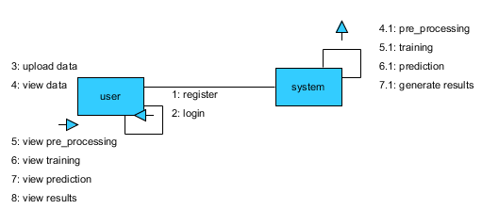

Slide 33
Deployment diagram:
Deployment diagram represents the deployment view of a system. It is related to the component diagram. Because the components are deployed using the deployment diagrams. A deployment diagram consists of nodes. Nodes are nothing but physical hard ware’s used to deploy the application.

Slide 34


Slide 35
Component diagram:
Component diagrams are used to describe the physical artifacts of a system. This artifact includes files, executable, libraries etc. So the purpose of this diagram is different, component diagrams are used during the implementation phase of an application. But it is prepared well in advance to visualize the implementation details. Initially the system is designed using different uml diagrams and then when the artifacts are ready component diagrams are used to get an idea of the implementation.

Slide 36
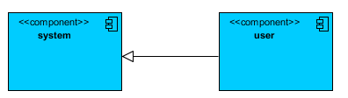

Slide 37
Activity diagram:
Activity diagrams are graphical representations of workflows of stepwise activities and actions with support for choice, iteration and concurrency. In the unified modeling language, activity diagrams can be used to describe the business and operational step-by-step workflows of components in a system. An activity diagram shows the overall flow of control.

Slide 38
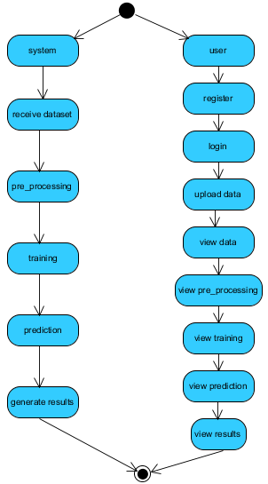

Slide 39
ER Diagram:
An Entity–relationship model (ER model) describes the structure of a database with the help of a diagram, which is known as Entity Relationship Diagram (ER Diagram). An ER model is a design or blueprint of a database that can later be implemented as a database. The main components of E-R model are: entity set and relationship set.

Slide 40
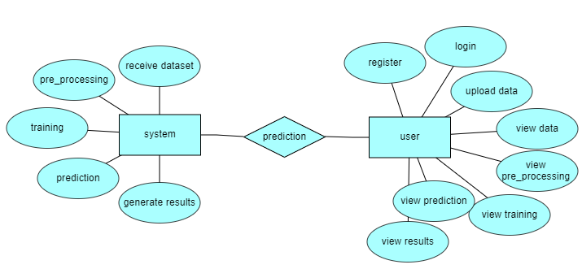

Slide 41
DFD Diagram:
A Data Flow Diagram (DFD) is a traditional way to visualize the information flows within a system. A neat and clear DFD can depict a good amount of the system requirements graphically. It can be manual, automated, or a combination of both. It shows how information enters and leaves the system, what changes the information and where information is stored. The purpose of a DFD is to show the scope and boundaries of a system as a whole. It may be used as a communications tool between a systems analyst and any person who plays a part in the system that acts as the starting point for redesigning a system.

Slide 42
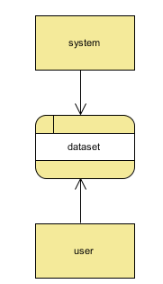
Context Level Diagram:

Slide 43
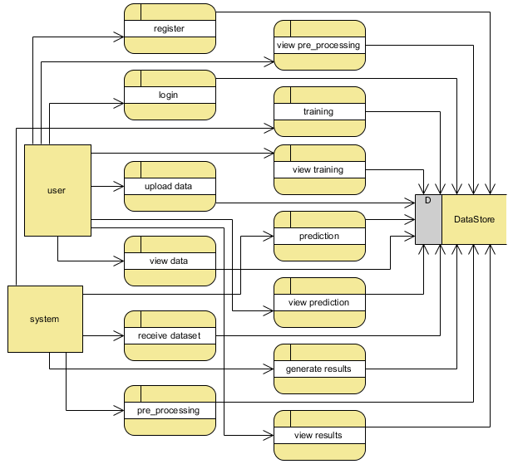
Level 1 Diagram:

Slide 44
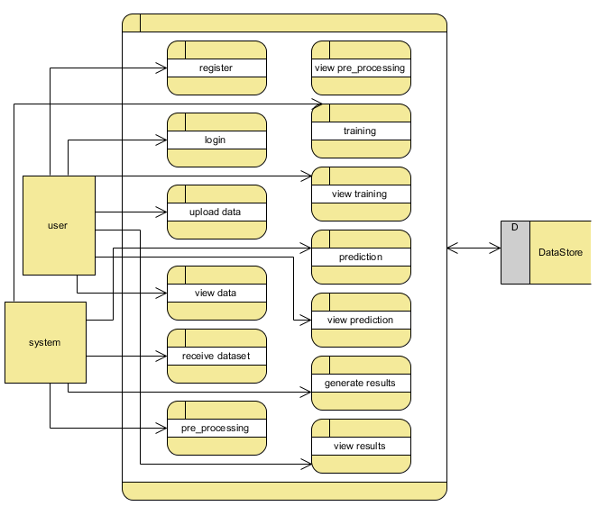
Level 2 Diagram:

Slide 45
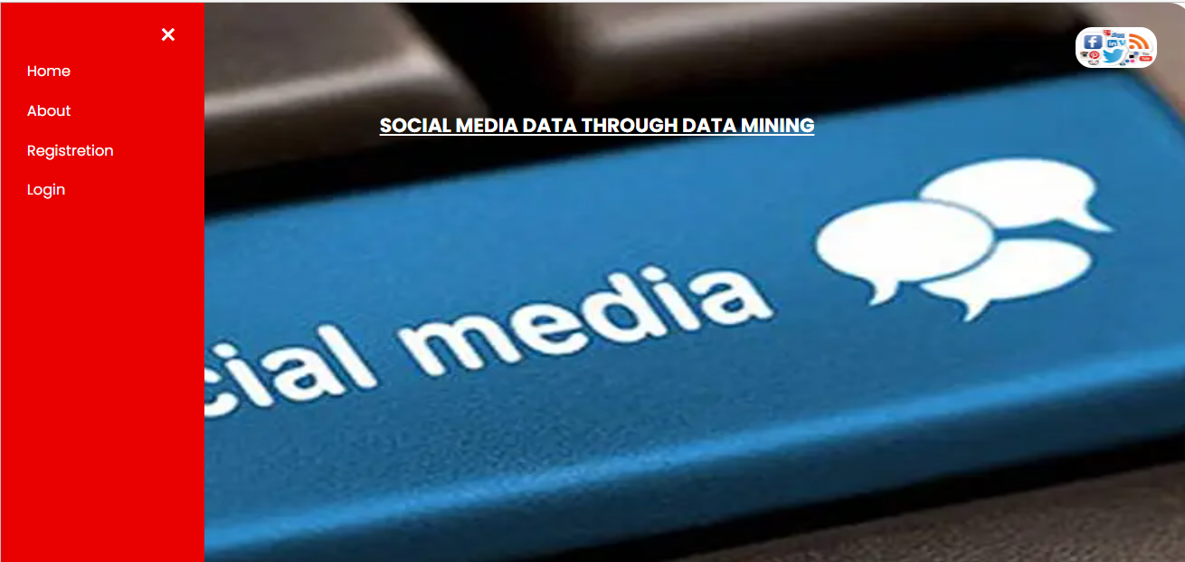
OUTPUT SCREEN SHOTS WITH DESCRIPTION.
Home Page: Home page of This Project
Fig2: Home Page

Slide 46
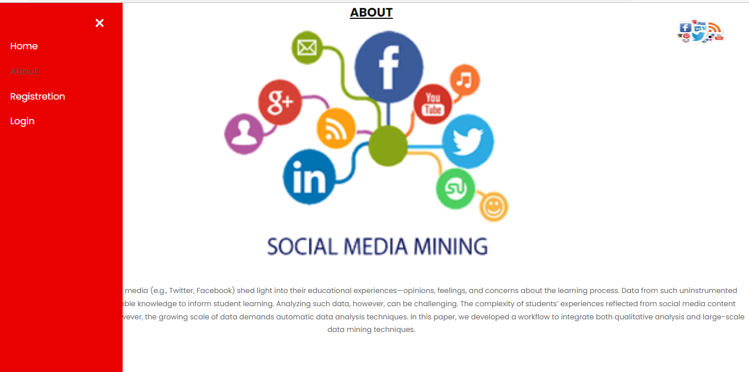
About: It’s a Small information about this Project
Fig3:About page.

Slide 47
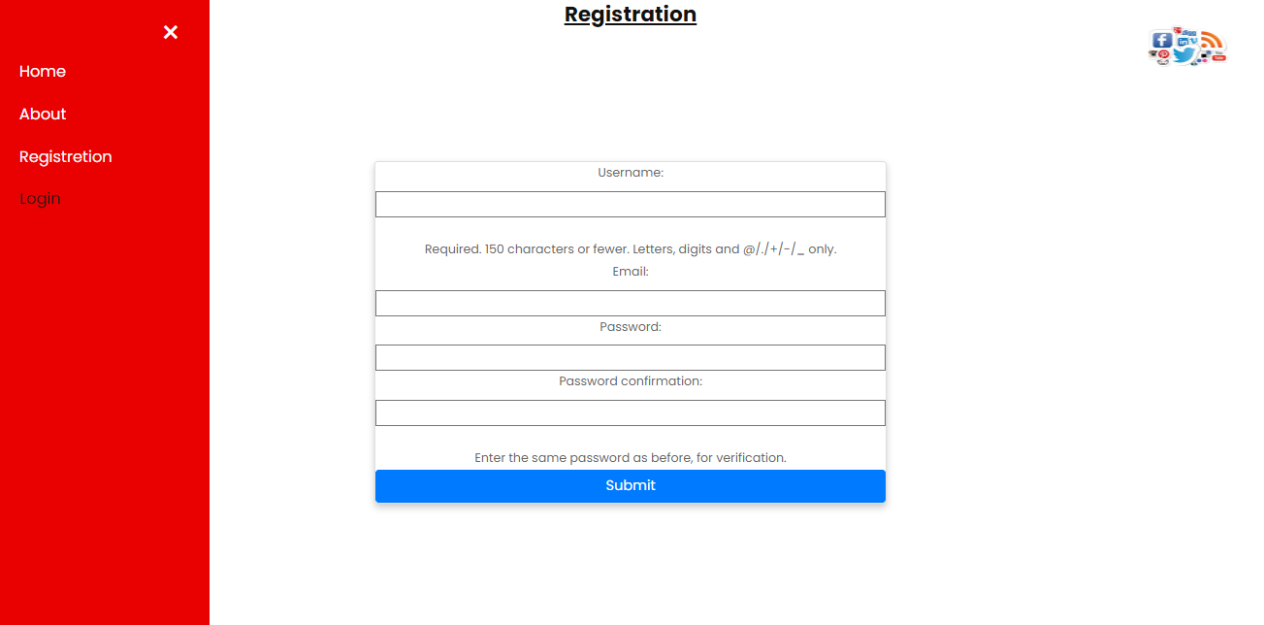
User Registration page: User can register with required details.
Fig3:Registration page.

Slide 48
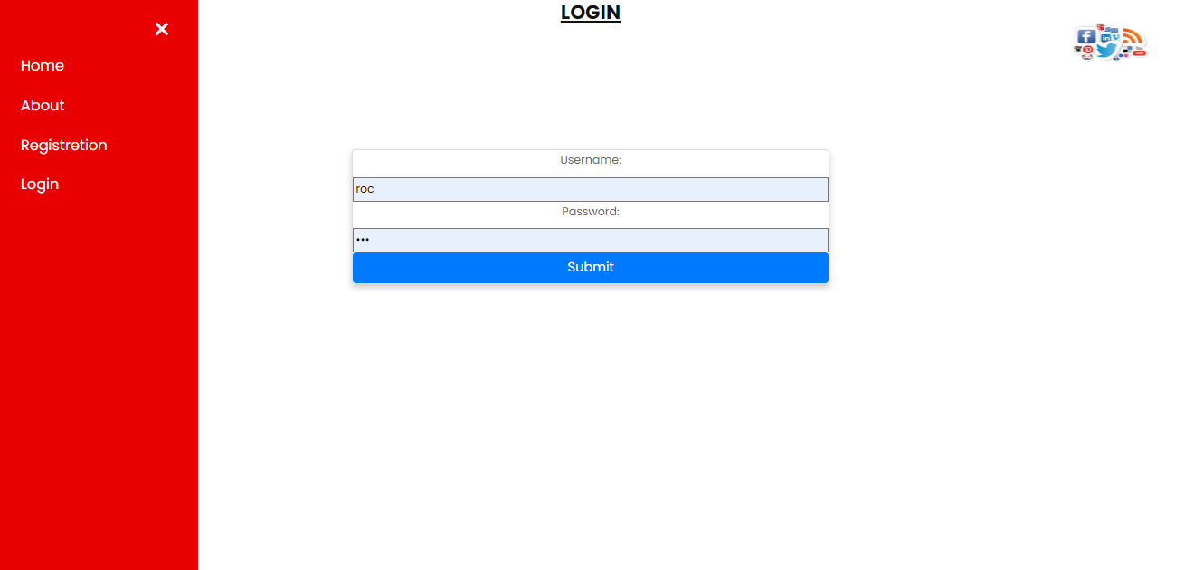
User Login: User can login with valid credentials.
Fig4:Login page.

Slide 49
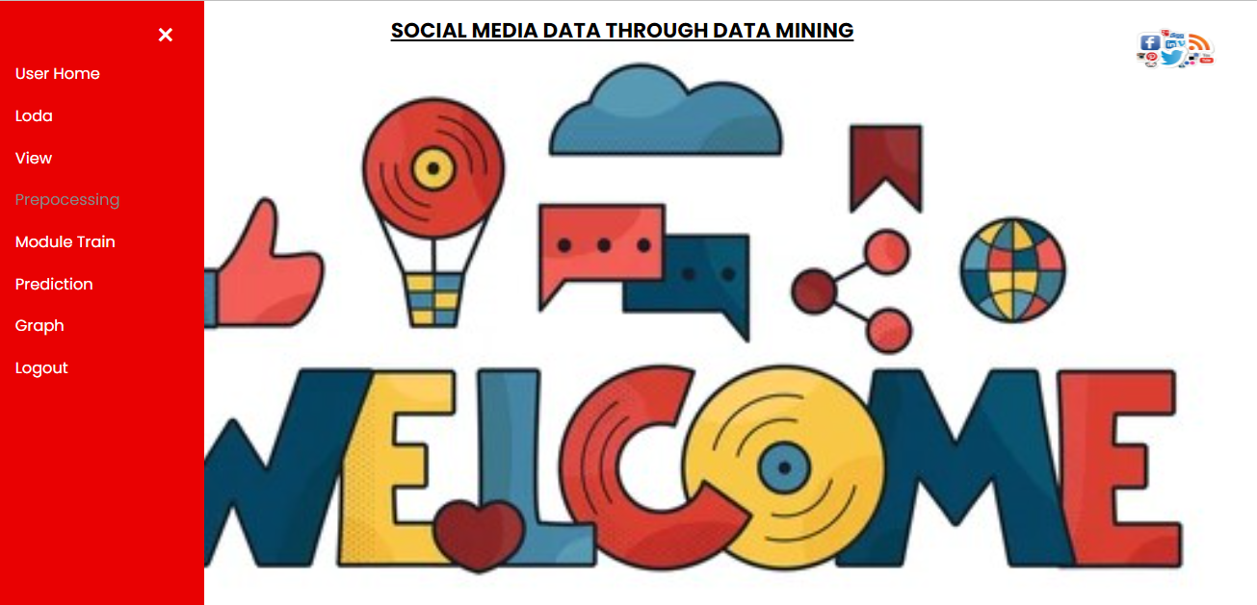
User Home page: User can view the home page after successful login.
Fig5:Uaer Hoam page.

Slide 50
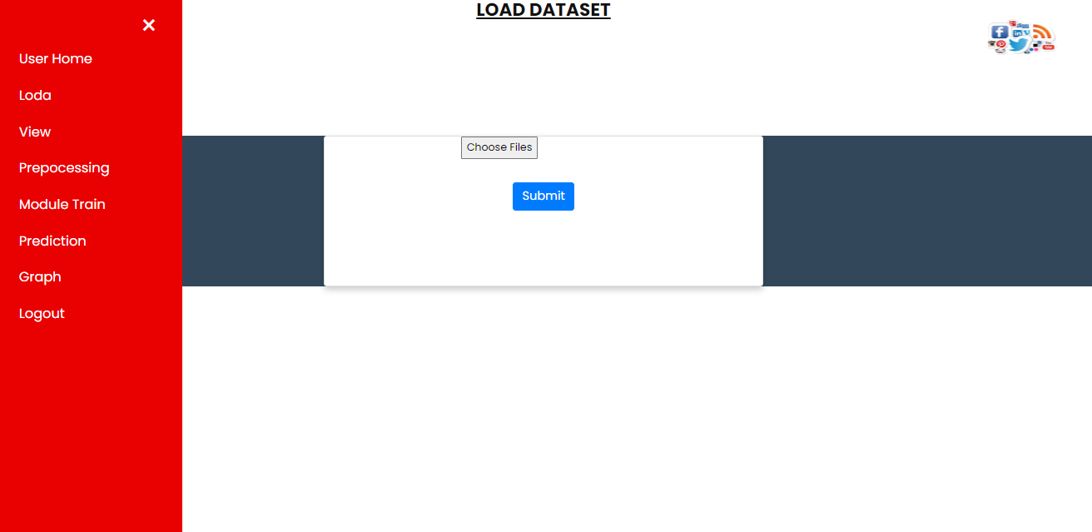
Upload data: User can upload the dataset
Fig6:Upload Data.

Slide 51
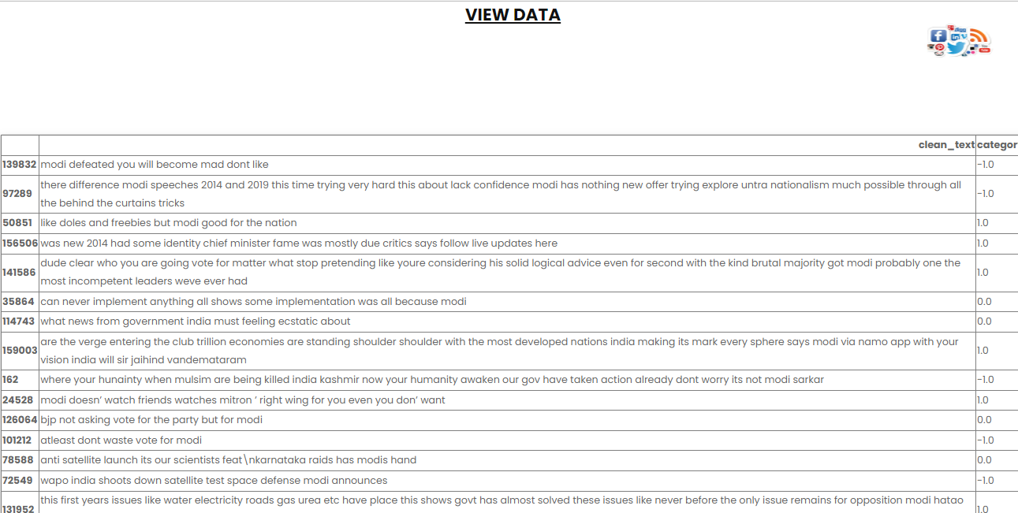
View: User can View The Data before Preprocessing
Fig7: View.

Slide 52
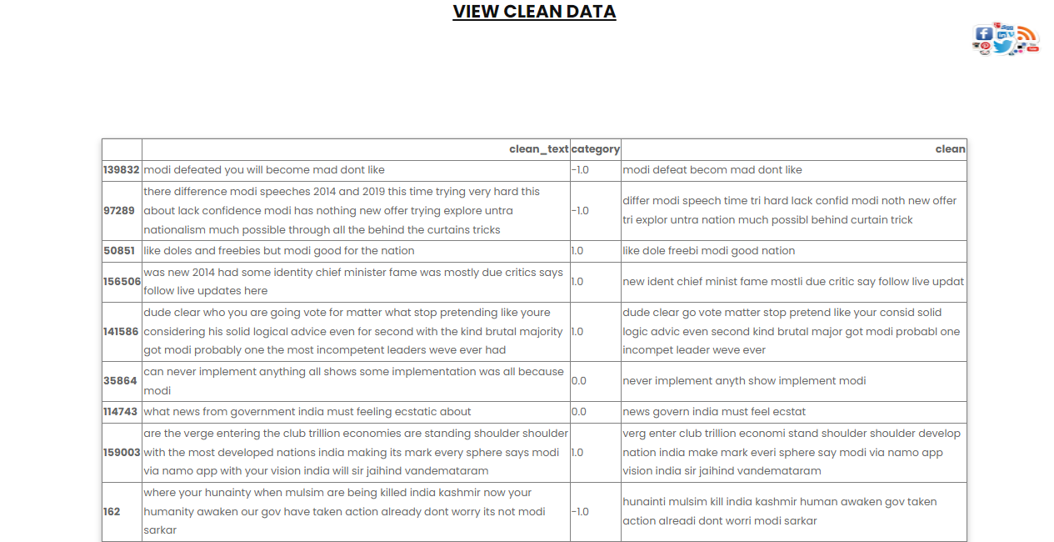
Preprocessing:User can View The Data after Preprocessing
Fig7: Preprocessing.

Slide 53
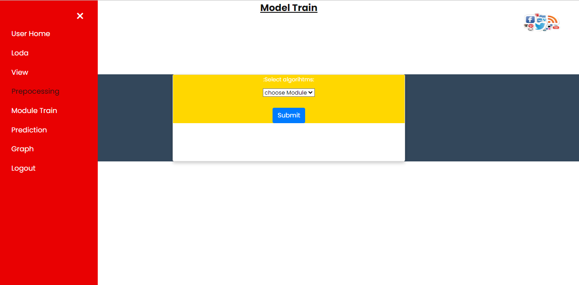
Training:
We’re training the algorithm to see which one has the best accuracy.
Fig8: Training Algorithm

Slide 54
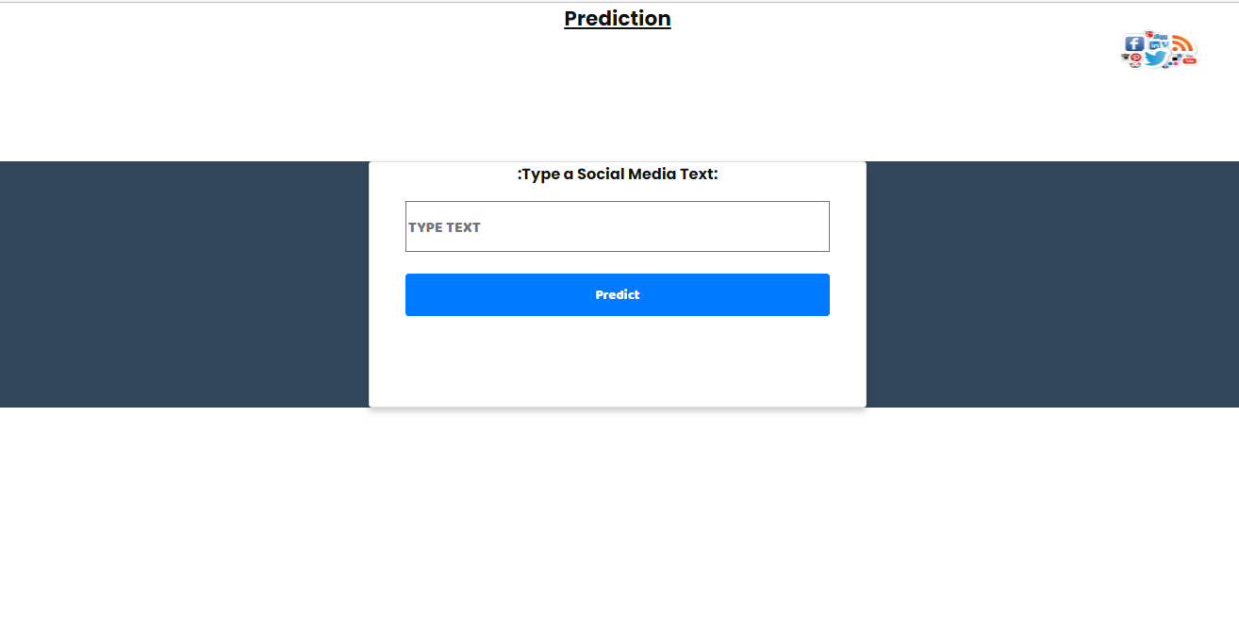
Prediction: User can give the input view the predicted result.
Fig9: Prediction

Slide 55
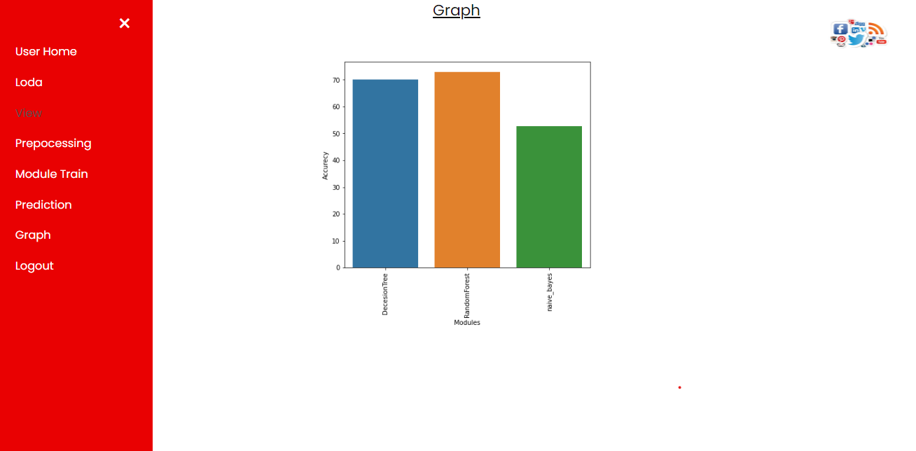
Graph: graph of accuracy of Decision tree, Random Forest and Naïve bias.
Fig9: Graph

Slide 56
CONCLUSION
In this project, we have developed a user friendly application called a Analysing social media data through data mining Using Machine Learning techniques such as Decision Tree, Random Forest, Naïve Bias, NLP We used the best techniques we found and its show the weather Positive are Negative are Neutral.

Slide 57
REFERENCES
[1] Levy, M. (2016). Playing with Twitter Data. [Blog] R-bloggers. Available at: https://www.r-bloggers.com/playing-with-twitter-data/ [Accessed 7 Feb. 2018].
[2] Popularity Analysis for Saudi Telecom Companies Based on Twitter Data. (2013). Research Journal of Applied Sciences, Engineering and Technology. [online] Available at: http://maxwellsci.com/print/rjaset/v6-4676-4680.pdf [Accessed 1 Feb. 2018].
[3] Zhao, Y. (2016). Twitter Data Analysis with R – Text Mining and Social Network Analysis. [online] University of Canberra, p.40. Available at:https://paulvanderlaken.files.wordpress.com/2017/08/rdataminingslides-twitteranalysis.pdf [Accessed 7 Feb. 2018].
[4] Alrubaiee, H., Qiu, R., Alomar, K. and Li, D. (2016). Sentiment Analysis of Arabic Tweets in e-Learning. Journal of Computer Science. [online] Available at: http://thescipub.com/PDF/jcssp.2016.553.563.pdf [Accessed 7 Feb. 2018].

Slide 58
[5] Qamar, A., Alsuhibany, S. and Ahmed, S. (2017). Sentiment Classification of Twitter Data Belonging to Saudi Arabian Telecommunication Companies. (IJACSA) International Journal of Advanced Computer Science and Applications, [online] 8. Available https://thesai.org/Downloads/Volume8No1/Paper_50Sentiment_Classification_of_Twitter_Data_Belonging.pdf [Accessed 1 Feb. 2018].
[6] R. M. Duwairi and I.Qarqaz, “A framework for Arabic sentiment analysis using supervised classification” , Int. J. Data Mining, Modelling and Management, Vol. 8, No. 4, pp.369-381 , 2016.
[7] Hossam S. Ibrahim, Sherif M. Abdou, Mervat Gheith, “Sentiment Analysis For Modern Standard Arabic And Colloquial”, International Journal on Natural Language Computing (IJNLC), Vol. 4, No.2, pp. 95-109, April 2015.
[8] Assiri, A., Emam, A. and Al-Dossari, H. (2016). Saudi Twitter Corpus for Sentiment Analysis. International Journal of Computer and Information Engineering, [online] 10. Available at: http://waset.org/publications/10003483/saudi-twitter-corpus-forsentiment-analysis[Accessed 1 Mar. 2018].

Slide 59
[9] L. Wasser and C. Farmer, "Sentiment Analysis of Colorado Flood Tweets in R", Earth Lab, 2018. [Online]. Available: https://earthdatascience.org/courses/earth-analytics/get-data-usingapis/sentiment-analysisof-twitter-data-r/. [Accessed: 01- Mar- 2018].
[10] D. Robinson, "Text analysis of Trump's tweets confirms he writes only the (angrier) Android half", Variance explained, 2016

Slide 60



